Slide 2
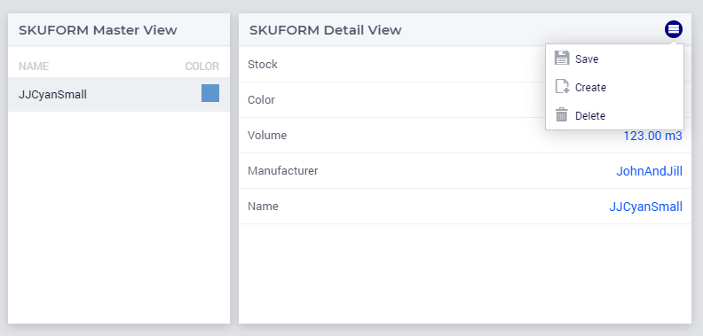
formData
Model Identifiers
Transaction
Check procedure

